Slide 1
STD- Short Term Disability
Use Case- Predicting who is likely to take STD within 90 days

Slide 2
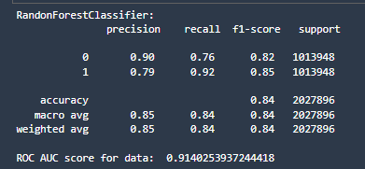
Classification Report on Train Data (After Smote)

Slide 3
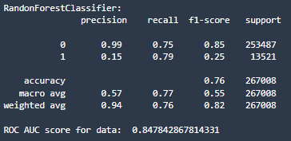
Classification Report on Testing Data

Slide 4
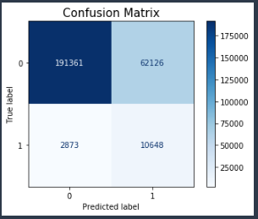
Confusion Matrix

Slide 5
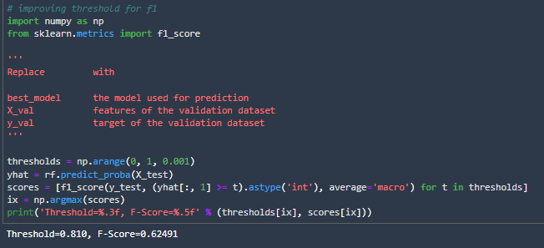
Improving Threshold for Macro F1

Slide 6
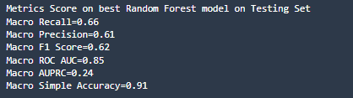
Metrics Score(Macro) on Testing Data

Slide 7
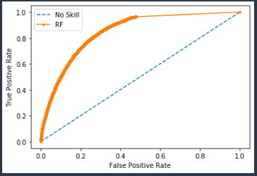
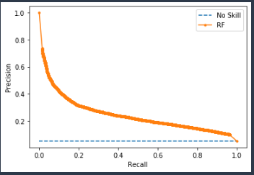
ROC AUC Curve
Precision-Recall Curve
ROC AUC = 0.85
AUPRC = 0.24

Slide 8
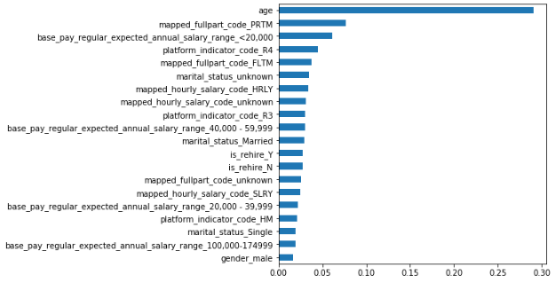
Top 20 Features from Random Classifier

Slide 9
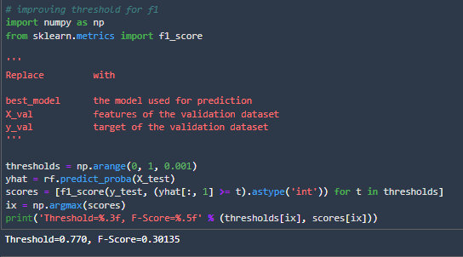
Improving Threshold for F1

Slide 10
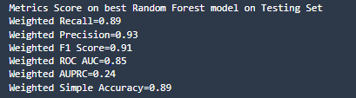
Metrics Score(Weighted) on Testing Data

